Slide 1



STUDIO SHODWE
HOME
SERVICE
ABOUT US
CONTACT US
PITCH DECK
Free Template Presentation
A presentation is a formal talk, often delivered in front of an audience, aimed at conveying information, persuading others, or sharing insights on a particular topic. Presentations can take various forms, such as verbal speeches, slideshows, demonstrations, or multimedia displays.
WWW.REALLYGREATSITE.COM

Slide 2



STUDIO SHODWE
HOME
SERVICE
ABOUT US
CONTACT US
INTRODUCTION
A presentation is a formal talk, often delivered in front of an audience, aimed at conveying information, persuading others, or sharing insights on a particular topic. Presentations can take various forms, such as verbal speeches, slideshows, demonstrations, or multimedia displays.
They are commonly used in academic, professional, and social settings to communicate ideas, proposals, reports, or findings. Effective presentations typically involve careful planning, organization, and delivery techniques to engage the audience and effectively convey the intended message.

Slide 3
STUDIO SHODWE
HOME
SERVICE
ABOUT US
CONTACT US
PROBLEM
Outdated Investor Databases
Spam and Inefficient Outreach
Startup founders struggle with accessing accurate, up-to-date VC contact information.
Finding relevant investors and avoiding spam consumes significant founder time and resources.

Slide 4

STUDIO SHODWE
HOME
SERVICE
ABOUT US
CONTACT US
OUR SOLUTION
AI-Powered Investor Search
An AI engine provides a curated list of relevant investors based on startup details.
AI-Generated Pitch Decks
AI assists in creating compelling and professional pitch decks, saving founders time and effort.

Slide 5


STUDIO SHODWE
HOME
SERVICE
ABOUT US
CONTACT US
MARKET OPPORTUNITY
Large Startup Market
Demand for Efficiency
Millions of startups globally seek funding annually, creating a massive potential user base for the platform.
Founders are constantly looking for ways to streamline fundraising, valuing time-saving tools and high-quality data.
Premium Pricing Model
Expanding Features
A subscription-based model allows for recurring revenue and the provision of premium features to paying users.
Future iterations can include investor relationship management (IRM) tools, further increasing platform value and user retention.

Slide 6

STUDIO SHODWE
HOME
SERVICE
ABOUT US
CONTACT US
Business Model
The platform operates on a subscription model. Users pay for access to the AI-powered investor search engine and the AI pitch deck generation tool. This recurring revenue stream supports ongoing platform development and data maintenance, ensuring high-quality information and connections for users. Premium features and tiered subscriptions will further optimize revenue.

Slide 7
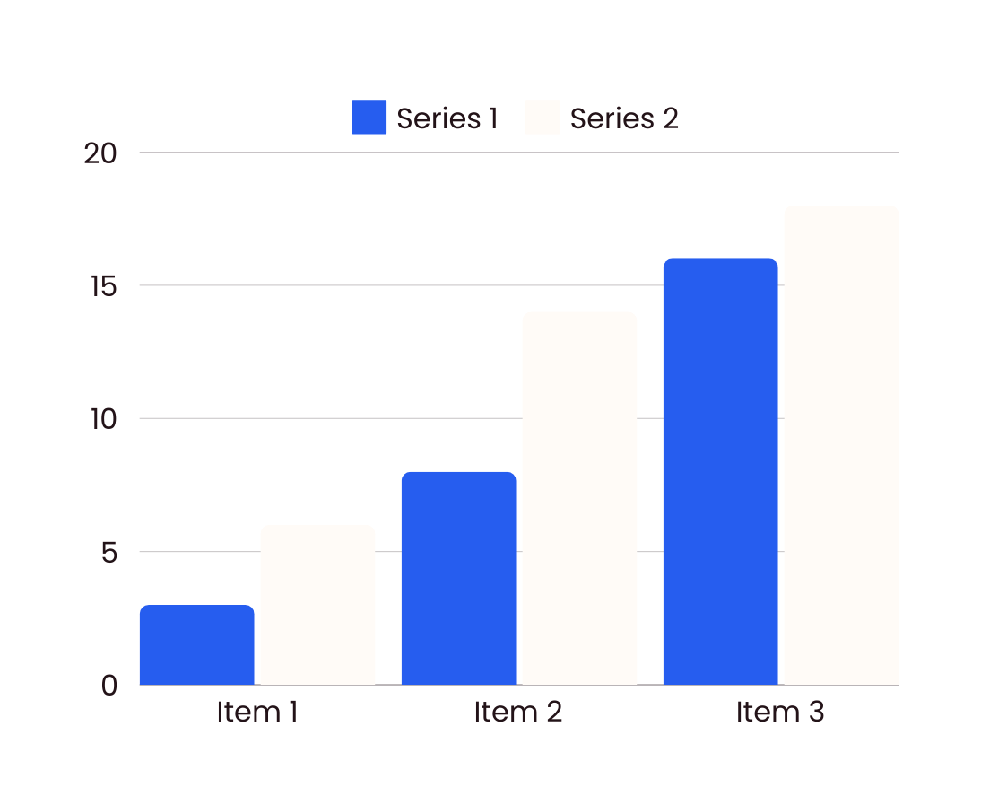
STUDIO SHODWE
HOME
SERVICE
ABOUT US
CONTACT US
FINANCIAL PROJECTIONS
A presentation is a formal talk, often delivered in front of an audience, aimed at conveying information, persuading others, or sharing insights on a particular topic. Presentations can take various forms, such as verbal speeches, slideshows, demonstrations, or multimedia displays.
Operational expenses
Marketing budgets
A presentation is a formal talk, often delivered in front of an audience, aimed at conveying information, persuading others, or sharing insights on a particular topic.
A presentation is a formal talk, often delivered in front of an audience, aimed at conveying information, persuading others, or sharing insights on a particular topic.

Slide 8




STUDIO SHODWE
HOME
SERVICE
ABOUT US
CONTACT US
OUR TEAM
Morgan Maxwell
Olivia Wilson
Neil Tran
Chiaki Sato
Job Title
Job Title
Job Title
Job Title

Slide 9







STUDIO SHODWE
HOME
SERVICE
ABOUT US
CONTACT US
CONTACT US
+123-456-7890
WWW.REALLYGREATSITE.COM
HELLO@REALLYGREATSITE.COM
123 ANYWHERE ST., ANY CITY, ST 12345

Slide 10


STUDIO SHODWE
HOME
SERVICE
ABOUT US
CONTACT US
THANK YOU
FOR YOUR ATTENTION

